Slide 1


Why Maps for HTML
Peter Rushforth
September 21st 2020
W3C/OGC Joint Workshop Series on Maps for the Web
w3.org/2020/maps/
Notes:
Good evening and good morning. I’m Peter Rushforth, and I work for Natural Resources Canada’s Centre for Mapping and Earth Observation, in the Canadian Geospatial Data Infrastructure division. Today I’ll talk about why we need to standardize maps for the Web, in HTML.

Slide 2
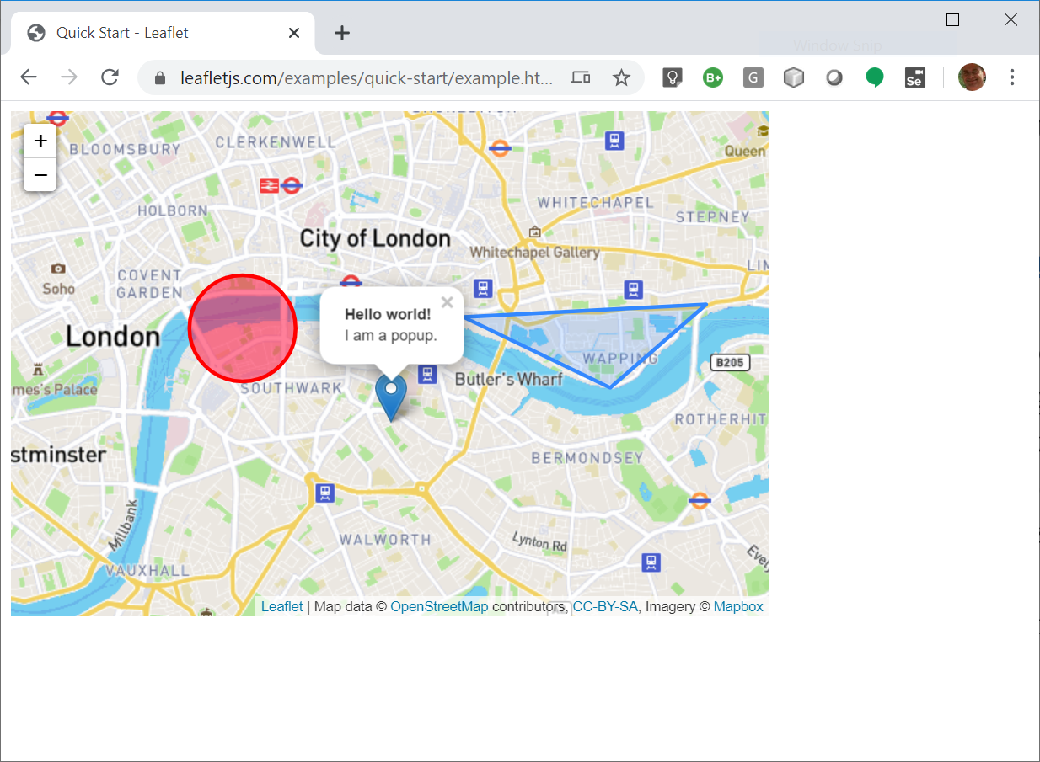
How To Make a Map For the Web
It’s easy… right?
Notes:
There are many reasons that people need or want to make Web maps. In the domain in which I work, it’s a requirement of most projects. But, how do you make a Web map? It’s easy… right? There are lots of ways to make a Web map, just need to pick a framework.

Slide 3












Choose a Mapping Framework
Notes:
Each framework has its merits. Some are easy to get started with. Some come with a bunch of free data layers built in. Others require significant knowledge and/or data manipulation and access to computing resources. Accessibility is not guaranteed, and easy to mess up. Interoperability pretty much does not exist.
In short, there is no “simplest” choice, and it can be a big decision. Once you decide, all the code you write belongs to you, except it’s bound to the framework you’ve chosen, making any change expensive and painful. The result….

Slide 4


The Result: Silos
https://commons.wikimedia.org/wiki/User:Mauryfrapi
Notes:
The result is silos. Although each Web mapping framework is somewhat similar, none share the same foundation and are they not interoperable, except in that the user can see a map. The result is bad for users, and the Web.

Slide 5
Why Do Silos Exist?
Intentionally: to create barriers to changing platforms e.g. Swift, Kotlin, React, PL/SQL
Accidentally: leave out a feature on your platform so that organizations have to create methods to accomplish their goals
Hanlon’s Razor: Never ascribe to malice that which can be explained by misunderstandings and oversights
Notes:
Why do silos exist? Silos might be caused by proprietary interests, such as those created to lock users into software platforms, but more likely they exist because we didn’t take the trouble to collaborate and eliminate the barriers or create interoperability.

Slide 6

This Workshop Is About Standards
Notes:
The proposal we make in this workshop is: Why don’t we work together to support all the users?
Mapping framework providers are all trying to serve their users.
Collectively, the sum of “their users” is ~equivalent to humanity as a whole.
All the map providers use the Web as a medium to deliver their products.
Together, let’s improve the Web to serve all of these providers equally well, possibly reducing their individual framework “responsibility”. Let’s make a standard that helps with the common core, that these providers can progressively enhance, if need be.
Let’s make a standard to serve users’ needs directly, e.g. through common accessibility, privacy (safety), linguistic and usability infrastructure, just as we try to do for users in the real world with roads, bridges, sidewalks, crosswalks etc.
While we’re at it, let’s make the standard a natural first step in learning, so that maps can be taught at school, giving children a common starting point for learning about geography and the Web, without frameworks.

Slide 7

Disappearing Silos?
Notes:
The Test of Independent Invention (TOII) first described by Tim Berners-Lee, is kind of a thought experiment.
The notion is that any new protocol or format must be designed for introduction into an environment that has incumbents, or it cannot succeed.
At the invention of the Web, FTP, gopher, WAIS existed in the mainstream already.
HTTP, HTML and URLs were designed to work *with* the existing protocols, somewhat satisfying the TOII, which can never be perfectly resolved (can’t make silos disappear, but over time they can resolve on their own).

Slide 8
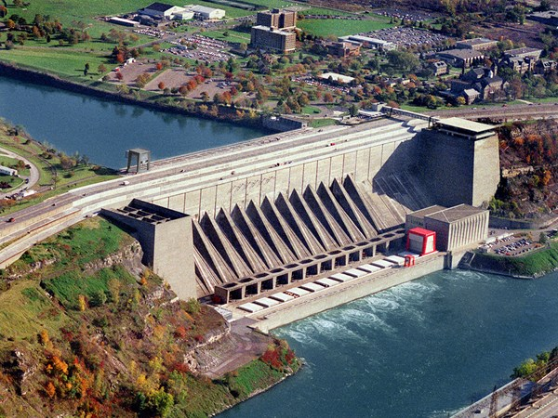






Real-World Infrastructure
Must be:
Safe
Fair
Durable
Cost-effective
Notes:
In the real world, “infrastructure” often describes public facilities created for the benefit of all, without prejudice
Infrastructure must be:
Safe – accessible, safe for everyone to use
Fair – inclusive, what good would roads and bridges be if you could only drive a Ford on them?
Durable – since everybody uses it, infrastructure must be built to serve and last.
Cost-effective – infrastructure should make it less costly for everyone to achieve their goals. Note that this doesn’t mean free, but it should be maximally shareable.

Slide 9
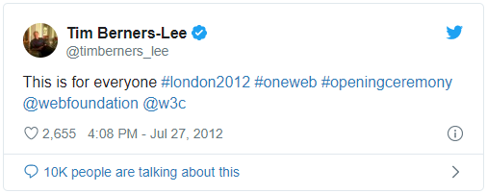

Virtual Infrastructure
Notes:
In the “virtual world”, the World Wide Web, and the software that supports it, is virtual, but nonetheless real infrastructure.

Slide 10

How To Avoid Creating More Silos?
Notes:
The situation in Web mapping standards is a little bit like this XKCD comic. There are probably more than fourteen different ways to create a Web map, and trying to make the situation better by adding another risks creating a worse situation.
What to do? Can we fix the situation by adding another standard? Probably not…
Many existing formats for geospatial information
If one of them was suitable, it would probably be a Web standard
Challenge is to create a new format that enables Web maps without requiring Web browsers to radically change (change of architecture impossible)
Proposed solution: Add/extend mapping elements to HTML
HTML is widespread, it is the foundation of Web architecture and browsers are based on processing it
BONUS: HTML already implements basic map ‘semantics’ (<img usemap=#foo src=…><map name=foo><area coords=x,y x,y x,y href=…></map>)

Slide 11

The Bedrock of Standards
HTML
Notes:
HTML pictured here, is the core language of the Web, and it was designed to bridge the divide between programmers and users. Ideally, it allows everyone to have access to content regardless of ability. Further, it is straightforward enough to allow users to become authors. This is embodied in the idea of “view source” culture, in which the medium itself teaches the user what is possible and how to achieve it.
Why are maps in HTML preferred over maps in JavaScript?
Because HTML requires and delivers:
Interoperability – the browser will become a spatial integration platform. Shared, standardized semantics mean interoperability.
Discovery – because of Rule of Least Power - Web pages could have location(s). Indexing pages by location(s), search engines will become spatial discovery platforms.
Inclusivity – understandable and creatable by authors who are not necessarily programmers, or mappers for that matter
Accessibility – because things, not just Web pages, have location, the browser will “tell” the user about their physical environment, as described by a Web map or Web site. For public spaces, real infrastructure will be represented also as virtual infrastructure.
Performance – less run-time cost to HTML than JS; (map) rendering is better suited to native code
Scalable – related to performance and inclusivity, and possibly other aspects, this means maps work in constrained OR powerful environments.

Slide 12
HTML Is the Web’s Standard Library
Declarative
A single element executes functionality that is pre-defined
Cross-platform like nothing before, since, or in the future; it is a platform in itself.
HTML
C++/Rust
Assembler
Binary machine code
Notes:
HTML is like the Standard Library of the Web. A single element encapsulates processing steps (especially rendering), from the layers below. Maps and location belong in the Web’s Standard Library, so that sophisticated applications can be built on top without having to ‘reinvent the wheel’.

Slide 13

HTML is Simple
Developers
Notes:
HTML is simple enough for a Web crawler to understand, but scales to underlie very sophisticated application development. Even though modern Web crawlers can execute Web applications to reveal the application-generated HTML and text content, they can’t understand semantics that aren’t there, such as maps and location, which don’t exist in HTML. Standardized location is important not only for search and discovery, but also for accessibility and internationalization.

Slide 14

HTML Is Standard
Notes:
A key aspect of HTML is that it is standard. Its elements have defined visual and accessibility semantics, making it inherently inclusive. Adding maps to HTML could aid important use cases for users, such as search and discovery, reducing the need for special-purpose catalogues, and the same linkability, or Web superpower, that allows crawlers to enable search and discovery will also enable map service federation and location information sharing. HTML is inherently cross-platform, making it the ideal target for standardizing location information. These aspects, taken together mean that maps in HTML will be more economically effective than our current silos, leading to better return on investments for society.

Slide 15
Does HTML Actually Change?
JavaScript
Yes, but…
HTML5 was a concerted effort, over a decade
Little appetite for similar efforts
The new process:
Extensible Web Manifesto:
Feedback from developer community (e.g. us)
Implementation by in browsers of evident needs
HTML / high-level requirements emerge
Goto 1.
HTML
Notes:
HTML 5 was a massive decade-long effort, and there’s little appetite in the Web standards community to repeat such an effort.
HTML does constantly change, however, and today the HTML standard itself is ‘evergreen’, with new ideas being integrated and browsers implementing constantly. How does the process work? Ideally, developers like us, who use JavaScript, HTML and CSS, provide feedback to Web platform (browser) engineers, who prioritize implementing ‘low-level’ features that are of use to the largest number of people. Often, these are features of JavaScript, but also CSS and HTML. As low-level features are implemented, the thinking goes, developers will develop ‘high-level’ features, as libraries or custom elements.
As the high-level functionality that becomes widely used, it thus becomes an emergent or de-facto standard. These de facto standards can then be implemented natively by browsers, giving rise to wider / and improved use of the Web and consequent generation of new requirements from new communities, like our own, participating in the virtuous cycle. And so on.

Slide 16
The Emergent GeoWeb
Notes:
That maps are an emergent characteristic of the Web, even constituting a GeoWeb, is obvious to the most casual observer.
That fact hides some thorny problems, however, and these problems can’t be solved by more and better libraries.
Architecture is problematic. For example, hyperlinks, the superpower of the Web and the heart of its architecture, are overwhelmingly under- or mis-used. This makes sharing, discovery and federation hard for users, and prevents the inclusion of geospatial information as part of the Web. On the positive side, OGC Web map services, APIs and content are highly standardized, so we can use these patterns and formats to adapt existing and hopefully future location services to the Web.
Another problem area is performance. In Web mapping, client rendering, that is the creation of DOM content by script, is the rule, so performance suffers, and styling is framework-driven/JavaScript-only, leaving Web standards only marginally involved. We need to engage the powerful browser render engines directly, through elements and styling tools specific to geospatial location and maps, so that rendering will be a more fairly divided responsibility between browser and script. The good news is that the constraints of Web map rendering has resulted in highly optimized formats, such as MapBox Vector Tiles, and well-defined and efficient client-server integration patterns, such as URL templates.
On today’s GeoWeb, maps are exclusively the responsibility of the framework developer, with Web dev consumers, accessibility is variable across frameworks and Web maps at large. This aspect alone makes maps worth standardizing in HTML.
Finally, feedback from geo developer community to the browser / standards developer community is mostly absent, representing a looming Tragedy of the Commons.
Collaborations such as that between W3C, OGC and the Maps for HTML Community Group are changing this situation, but more needs to be done.

Slide 17
Maps in HTML of the Future
<!DOCTYPE html>
<html>
<head>
<title>Future Web Map in HTML</title>
</head>
<body>
<map zoom="13" lat="51.505" lon="-0.09" controls>
<layer label="Open Street Map" src="http://example.com/mapml/osm/" checked>
</map>
</body>
</html>
Notes:
Maps in the HTML of the future might look like this, starting with a <map> element, containing one or more child <layer> elements. There already exists a somewhat neglected <map> element in HTML with similar enough semantics to provide a good extension point, in keeping with the HTML Design Principles. By specifying a new child <layer> element, HTML could immediately incorporate dynamic Web map semantics as commonly understood, providing the shareable infrastructure that Web maps and geospatial information require.

Slide 18
HTML Has Evolved Over Time
Text - <p>
Images - <img>
Vector graphics - <svg>
Audio - <audio>
Video - <video>
Mobile / Responsive - <img srcset>, <picture>
Maps - <map>
Notes:
HTML began as simple text documents, linked together. It was the linking that made them special. Linking has been described as the Web’s “superpower”. Over time, media types have been added in response to user needs most recently with the advent of the Mobile Web and responsive design. Maps should be the next big thing.

Slide 19
How Does Feedback Happen?
Feedback from developers (e.g. you)
Implementation by browsers communities
HTML requirements emerge
Goto 1
Join and contribute to the Maps for HTML Community Group:
maps4html.org
The annual Mozilla Web Developer Needs Assessment
– WebDNA - mention maps (and MapML!).
Notes:
So, where actually is this virtuous feedback loop of which I spoke?
The Maps for HTML Community Group was created, based on the conviction that Web mapping is an emergent or de facto standard of the Web as sought by the Extensible Web Manifesto. The main way to provide feedback to the browser standards community is for you, especially representing your organization or company, to join the Maps for HTML Community Group to contribute ideas, comments and even code.
Another important path for feedback from Web mapping community to the Web platform folks, is the annual Mozilla Web Developer Needs Assessment, or Web DNA, survey. Please share the link. Mention Web mapping! Mention Maps in HTML!

Slide 20
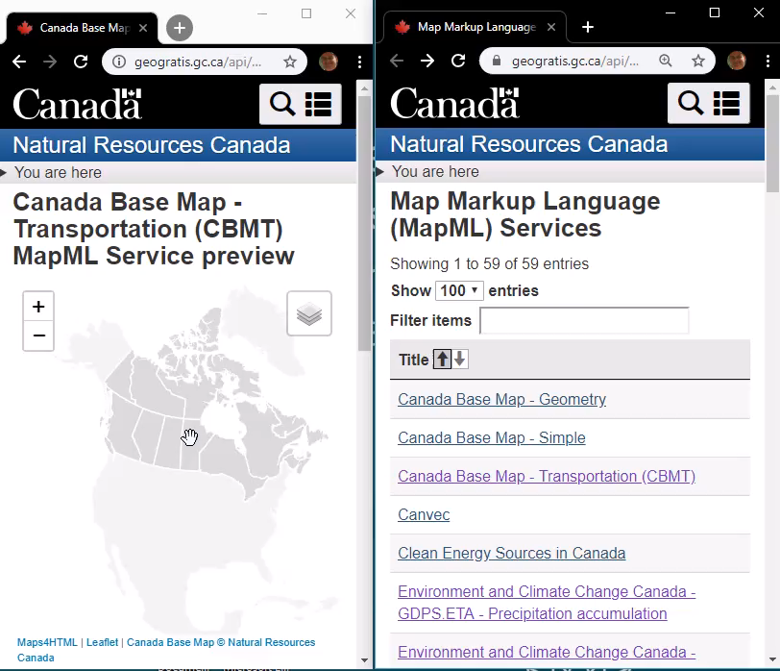



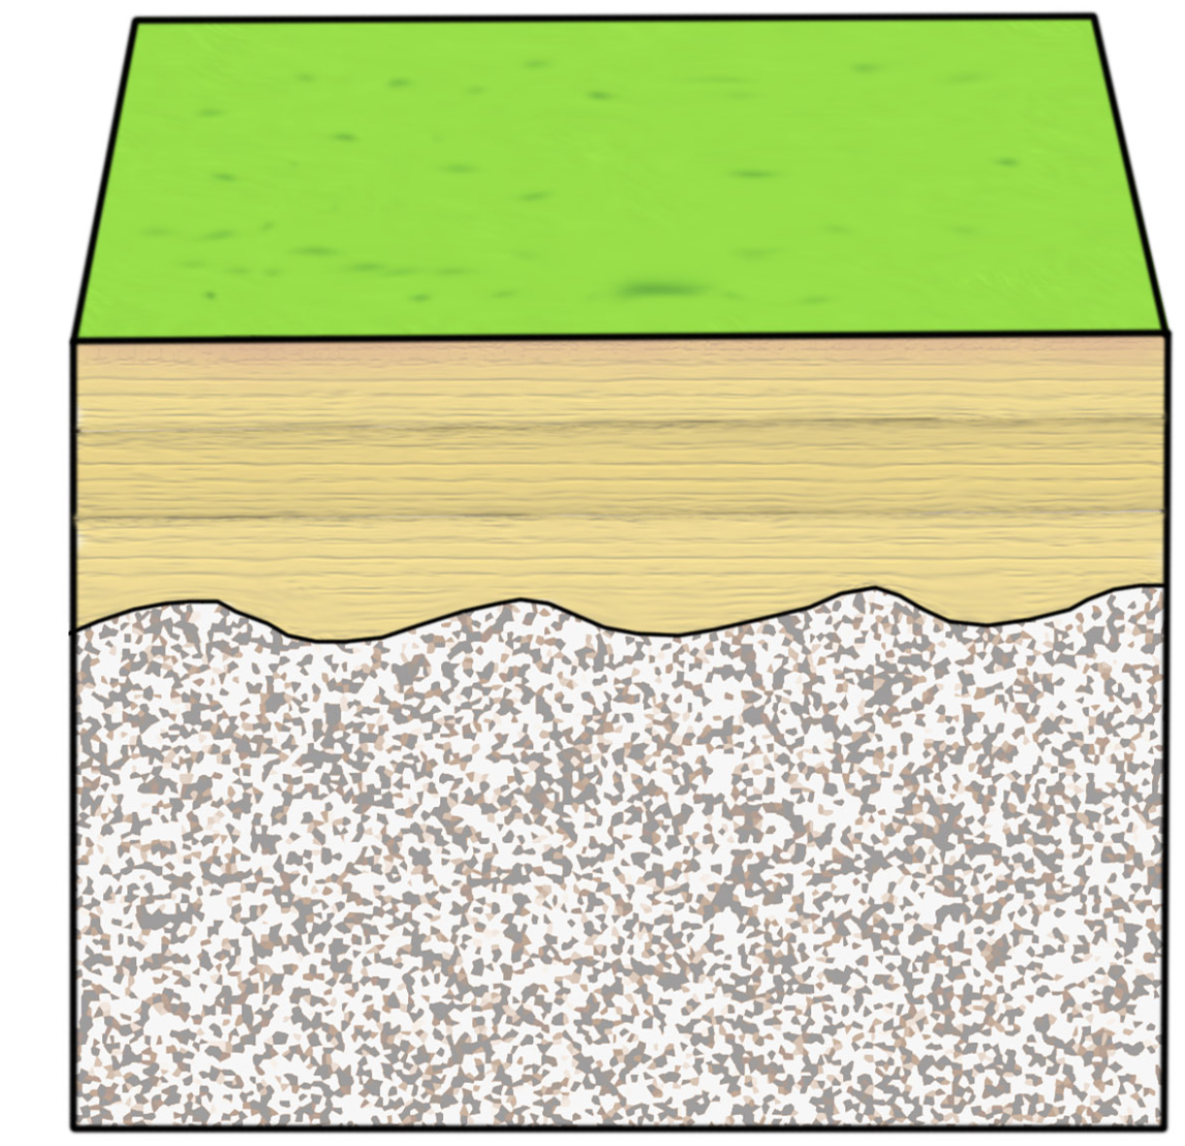
The Interoperable GeoWeb of the Future
Users
Users
Sharing – Linking To Infrastructure
Search - Discovery
Progressive Enhancement – “JavaScript”
Developers
Developers
Progressive Enhancement – “CSS”
HTML Map Content – “MapML”
Links – Forms – Tables
HTML Design Principles
Existing Geospatial Content
Notes:
A key feature of the URL-driven Web of HTML is the ability to share documents using their URL. This feature of the HTML Web also enables linking within and between resources, not to mention search and discovery. This simple architectural characteristic could make a GeoWeb of the future a benefit to users around the globe, and to the interests that rely on it, in other words everyone.

Slide 21


Maps in HTML Can Happen by Working Together
Notes:
HTML will provide a common foundation for maps and location for all stakeholders. Spatial information is infrastructure, and a standard that represents its common foundation will unlock the true value of that infrastructure. Maps, standardized in HTML, will allow us to encode and share our understanding of the world. Let’s achieve the understanding of our physical world by enabling the representation of that world in HTML, together.

Slide 22
THANK YOU! Merci!
Peter.Rushforth@canada.ca
September 21st 2020
W3C/OGC Joint Workshop Series on Maps for the Web
w3.org/2020/maps/
Notes:
Thank you

